Slide 1
Welcome to: Visualization with D3
Frank Elavsky, Data Visualization Specialist, NUIT
Notes:
3

Slide 2
Optional: Pre-Requisite JS:
Before we start into d3, let’s examine some JavaScript.
Notes:
3

Slide 3
Soul-Crusher
Notes:
3

Slide 4
Good News/Bad News
What I am about to tell you will be great if you are a ‘Mastery’ individual
What I am about to tell you will be difficult if you are an ‘Achievement’ individual
Everyone is different! But it is good to know the frustrating stuff up front.

Slide 5


Slide 6
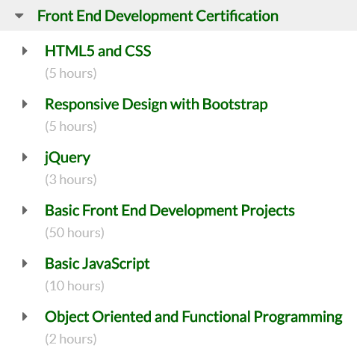
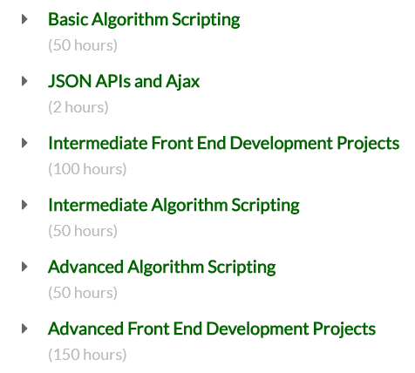
477 hours minimum, pre D3

Slide 7
learnwebdev.com:
11.5 hours for JavaScript alone

Slide 8

~10 hours reduced to 2
Notes:
You’re only going to get the JavaScript you need to start working in D3, you won’t get even close to a working grasp of the language at it’s full capacity

Slide 9
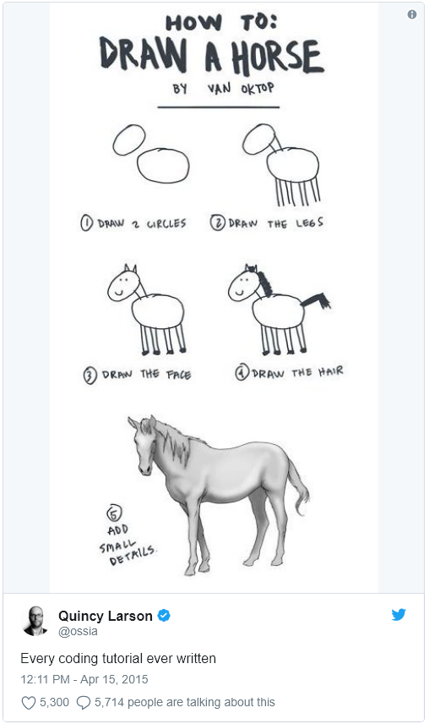

Slide 10
This Repo:
https://github.com/nuitrcs/Intro_to_d3_workshop
Notes:
2

Slide 11
Before I say anything, write this down:
console.log(this)

Slide 12
console.log(this) is your most powerful weapon
Use it. All the time.
It is your 6th sense in frontend development: it lets you ‘see’ where you are in your code and the DOM. It is your eyes into your scope, your selections, and your life.

Slide 13
Getting Started:
Task #1: Get your tools
Get a text editor: Sublime, Atom, Notepad++, or Brackets
Make sure you have either Chrome or Firefox
Task #2: Open your stuff
Open the “barchart_ready.html” file in your browser
Open the “barchart_ready.html” file in your text editor
Notes:
8, 6 & 2

Slide 14
A note about this dev environment
I will not be teaching: IDEs, task-runners, linting, sass, frameworks, or anything that you might want to consider in a full production environment
Why? Because those are beyond even the intro ‘10’ hour tutorials for JS. These are not within the scope of what we are learning – which is how to create things in D3.

Slide 15
Task #3: Some library-level JavaScript
Open ‘controller.js’ in your text editor, let’s walk through this

Slide 16
Task #4: Understanding AJAX failures
Open ‘barchart.html’ in CHROME
Open the inspector to read the error message

Slide 17
Task #5: Setting up a local server
Node.js:
From command line: npm install http-server –g
Run process.bat
Resource: https://github.com/indexzero/http-server
Python
Navigate to dir
Run:
Python 3x: python -m http.server
Python 2x: python -m SimpleHTTPServer
Resource: https://developer.mozilla.org/en-US/docs/Learn/Common_questions/set_up_a_local_testing_server

Slide 18
Port note:
You may need to specify a unique port number, if we all share an internal IP
Node: call http-server -p 9876 -c-1
Python: python -m http.server 9876

Slide 19
Task #6: Loading Async
Rename barchart.html to index.html
Navigate to http://localhost:[port]/ in your browser
Open the “index.html” file in your text editor
Observe differences between the two:
Data importing is different, odd JavaScript happens in barchart.html
A callback is used in barchart.html (this makes it async!)

Slide 20
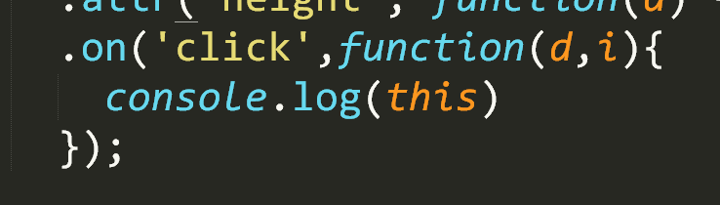
Task #7: Click Events – the easy way
Notes:
Explain generic functions, a thing in javascript
Console.log(this) and d and i

Slide 21
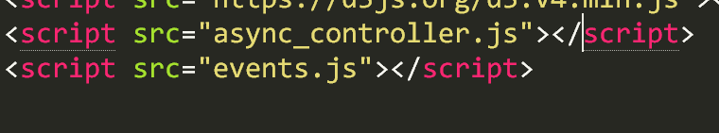
Task #8: Add a new javascript file

Slide 22
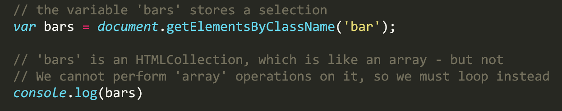
Task #9: Selecting

Slide 23
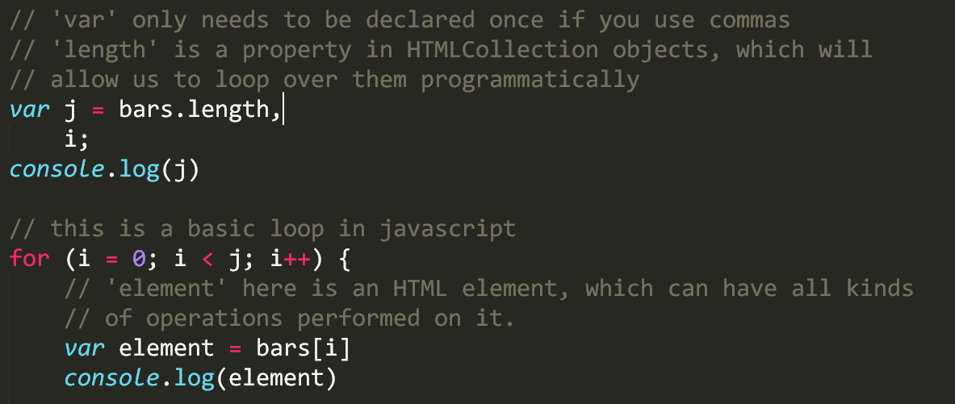
Task #10: Looping over a selection

Slide 24
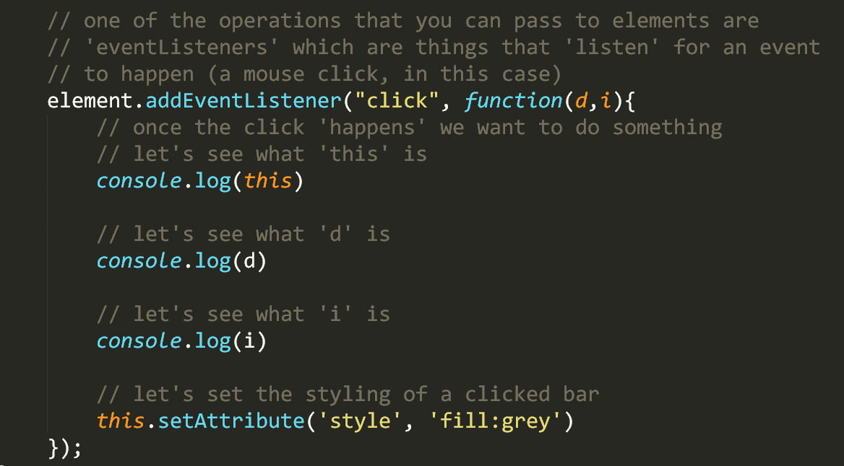
Task #11: Click events – the hard way

Slide 25
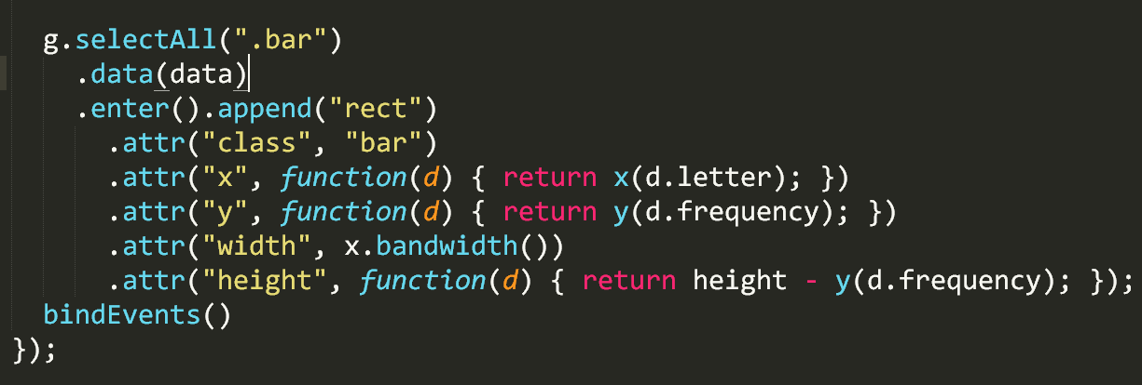
Task #12: Binding in a callback
(navigate to ‘async_controller.js’)

Slide 26
Questions?
Commonly asked JS:
What is the ‘development’ environment for JavaScript?
Is JavaScript compiled?
What is a library versus a framework?
What is an ‘API’? What is the ‘web API’?
Why is this all so complicated?
What is ‘loosely typed’?
Commonly asked D3:
Why would I ever use [sync]/[async]? X is obviously better.
Why is D3 so hard?

Slide 27
Now: Introduction to D3.js
Hands-on learning and plenty of resources.
Notes:
3

Slide 28
What is D3 capable of?
https://ligo.northwestern.edu/media/mass-plot/index.html
http://www.r2d3.us/visual-intro-to-machine-learning-part-1/
http://bit.ly/2wJEeIy
http://nbremer.github.io/urbanization/
https://www.nytimes.com/interactive/2014/upshot/buy-rent-calculator.htmlhttps://bost.ocks.org/mike/algorithms/
Notes:
3

Slide 29
But why is it so hard?
Why not just something like d3.call(bargraph).with(my_data)?
These solutions exist and you should use them when appropriate:
vega/vega-lite/altair
plotly
ggplot2
matplotlib
Notes:
1

Slide 30
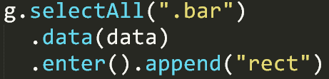
Two very important things:
Binding data to the DOM
Low-level geometric expressiveness
Notes:
3

Slide 31
Think of making a cake
How do most people do it?
Notes:
1 “Is box-cake even good though?”

Slide 32
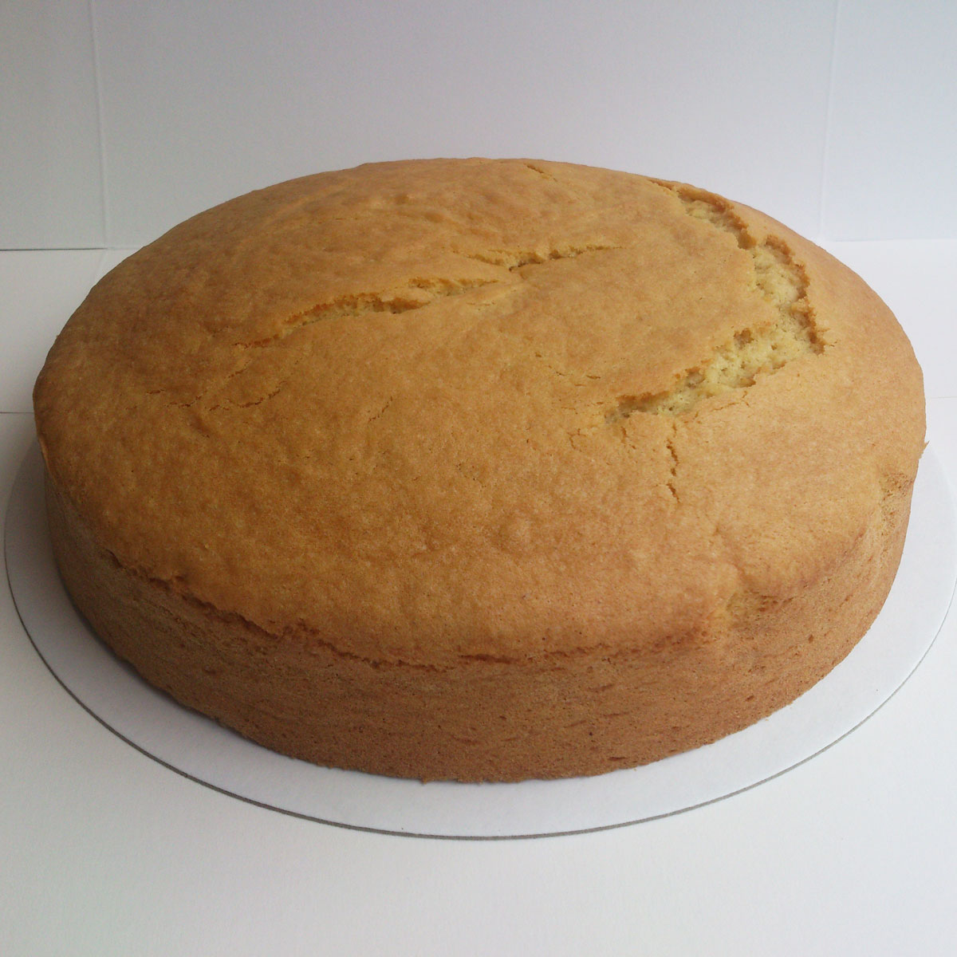
Microsoft Excel
Notes:
1

Slide 33

Plotly, ggplot2, Matplotlib
Notes:
1

Slide 34
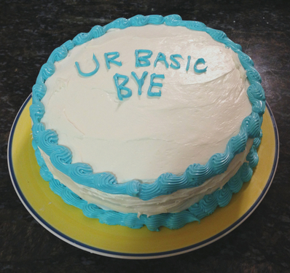
Tableau, Vega
Notes:
1

Slide 35

D3 is tiramisu
Notes:
1

Slide 36

Or whatever cake you want
Notes:
1

Slide 37
“Boxed” cake is easy
Eggs + water + their pre-mixed flour,
Bake,
and then if you have the time: add frosting
In the end? Boring!
Notes:
1

Slide 38
Cake “from scratch” is hard:
You have to think about each ingredient, its quality, its needs
You must imagine your end-result + find a useful recipe
It can take a long time to master each ingredient
In the end? A unique masterpiece!
Notes:
2

Slide 39
Cake from Scratch
A “grammar of graphics” is key:
How do we talk about and use the core ingredients in any visualization?
Notes:
1 “Learn by doing” IDEAL: 15:00, latest TARGET = 22:00

Slide 40
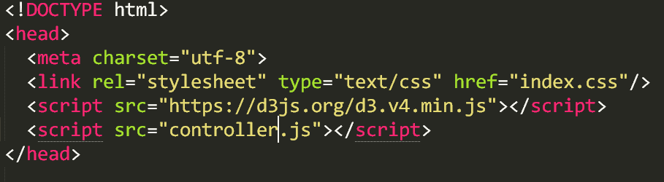
Task 1: Build your environment
Create a folder somewhere with these inside:
Build index.html file with d3 source link (local or web)
Create empty “index.css” file, link it in your html
Create empty “controller.js” file, link it in your html
Notes:
8

Slide 41
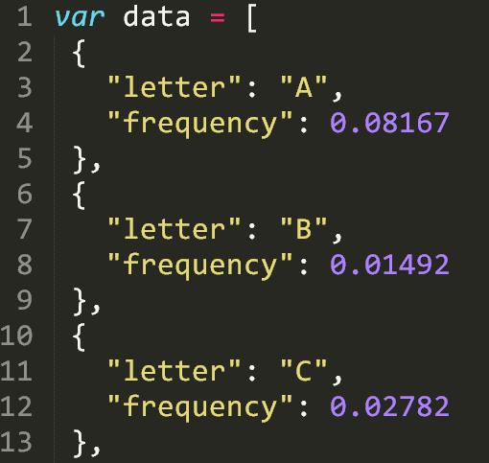
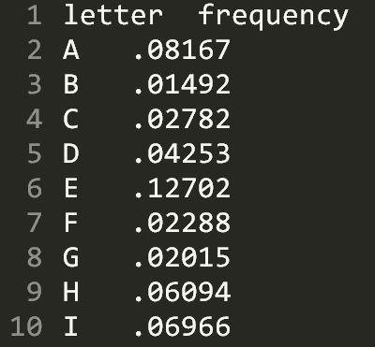
Task 2: Look at our data, literally
Open both data.tsv and data.js in your text editor
Notes:
4

Slide 42
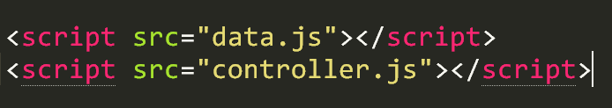
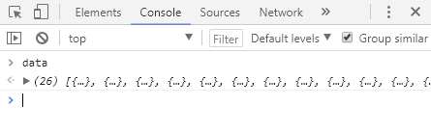
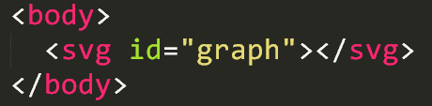
Task 3: Look at the data, in-browser
Import data.js into your html
Console.log the data in the browser console
Create an <svg> element with id=“graph” inside <body>
Notes:
6

Slide 43
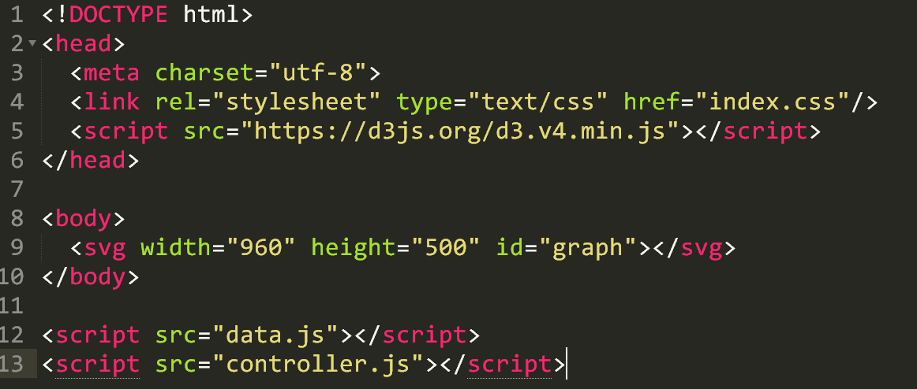
(Review) HTML layout should look like:
Notes:
3

Slide 44
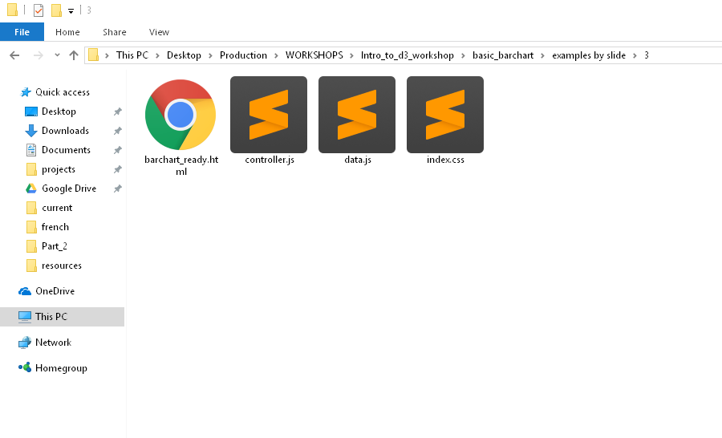
(Review) File system should look like:
Notes:
3

Slide 45
Begin writing code!
Let’s recreate this monster (follow along)
Notes:
1 – TARGET = 54:00, else -1 min each slide

Slide 46
1a. Beginning with D3
Once we get set up, we should only visit controller (and css)
Select the “#graph” element
Reference this with a var
Give it dimensions
Append g
Reference this g with a var
g.selectAll(‘.bar’)
.data(data)
.enter().append(‘rect’)
Discuss SVG types & explain SVG
Notes:
6

Slide 47
1b. Use the bound data!
Make height = d.frequency
Make width = 10
Make x = i*10
Try:
Make height = 1000x the frequency
Make width = 20
Make x = i*22
Notes:
6

Slide 48
1c. How to inspect
Show __data__ property of the element
Show console.log(this)
(i)
(d)
d3.select(this)
Notes:
6

Slide 49
2. Build a scale that makes sense
Create margin object
Create “actual” width/height variables, subtracting the margins
Pass these to x range - band (width) and y range - linear (height)
Pass our data to the domain, using map for letters and max for frequency
Update our attr binding to use these new things
Notes:
6

Slide 50
3. Add the axes and some styling
Append g with an axisBottom on x, translate for height (to put on bottom – otherwise it is a downward axis on the top)
Append g with an axis for y, add 10 ticks with %
Open our empty index.css
Add fill color for .bar class and .bar:hover
Remove axis--x path
Notes:
6

Slide 51
Resources
Things you should explore when looking further

Slide 52
Read the API docs!
D3: https://github.com/d3/d3/wiki
Web: https://developer.mozilla.org/en-US/

Slide 53
Top 3 resources:
The d3 API documentation
MDN web standards documentation
Googling things you want to make (“d3 scatterplot bl.ocks”)

Slide 54
Listing the Basics:
Know what these are, you will use them often:
Selections (select, selectAll and how they work)
SVG types (circle, rect, text, path)
Data Enter/Append
Data Exit/Remove
Chaining
Attributes+Transitions
Arrays: Min/Max/Range, Keys, Merge, Nest
Scales
Color
Axes

Slide 55
Design Basics for Charts
http://bit.ly/1RfYZxm
Worth mentioning: There are additional slidedecks by the above authors on Maps, Pie Charts, and even Data Tables

Slide 56
Advanced d3 Abilities
Curve Interpolations: http://bit.ly/2xR9VxX
Voronoi: http://bit.ly/2gK35mi
https://bl.ocks.org/mbostock/4060366
Zooming: http://bit.ly/2f6WYsg
Brushing/Zooming: http://bit.ly/2lTjfef
Stacking: http://bl.ocks.org/mbostock/582915
Collision Constraint: http://bit.ly/2vOPk05
Dragging: http://bit.ly/2j6x5gH
“Each”: https://bl.ocks.org/mbostock/9490313
Dispatching (super advanced): https://bl.ocks.org/mbostock/5872848
Modules/Plugins (most advanced):
https://bost.ocks.org/mike/d3-plugin/

Slide 57
SVG Documentation
https://mzl.la/1nP24aN
Check it: this is good to be familiar with, as is all of MDN

Slide 58
SVG Level 2
http://bit.ly/2xdgJsI
Plug: VisualCinnamon is extraordinary. Their work on SVG in particular is the best I have found to date.

Slide 59
Maps in D3
http://bit.ly/2f7o4Q5
http://oreil.ly/1UnNtFe
Warning: This is advanced level!
Also: The d3 library contains geo maps of many kinds already.

Slide 60
D3’s Extensive Library:
https://github.com/d3/d3/blob/master/API.md
Statistics, histograms (4 kinds), ES6’s Map/Set, Nesting, Data Ingestion (CSV, TSV, etc), many animation/easing/time options, force/physics, geography and projections, spherical maps/math, and that is just the first 25% of it:

Slide 61
Canvas and D3
http://bit.ly/2xRh9Ci
Important: Canvas is a native web technology, similar to SVG. You can google the comparisons, but it is a good option if you need serious performance over visual quality.

Slide 62
Data Processing in JS
http://learnjsdata.com/index.html
Note: optional resource. This is very nice to have handy.

